Slide 1
Course 2 Module 5 Programming Assignment ETL MIMIC data into the OMOP CONDITION_OCCURRENCE table

Slide 2
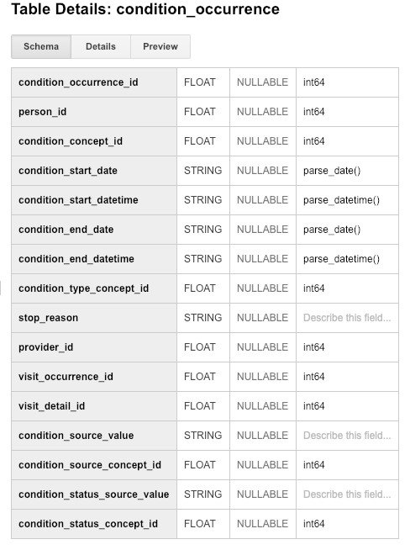
Step 1: Understand source/target data models
CONDITION_OCCURRENCE is the TARGET OMOP table.

Slide 3
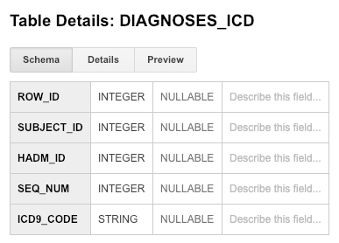
Step 1: Understand source/target data models

Slide 4
Step 2: Profile source table or tables
DIAGNOSES_ICD contains 1761 entries and contains the fields SUBJECT_ID and HADM_ID
ADMISSIONS shows there were only 129 hospital admissions
PATIENTS shows there were only 100 different patients
Need to explain the discrepancies between DIAGNOSES_ICD and the other two tables
Notes:
The White Rabbit output indicates that DIAGNOSES_ICD contains 1761 entries, for 1761 different diagnoses. However, this table contains the fields HADM_ID and SUBJECT_ID. PATIENTS shows there are only 100 patients while ADMISSIONS shows there are only 129 hospital visits. As a result we need to justify the large number of diagnoses.

Slide 5
Step 2: Profile source table or tables
Running the following query returned 100 and indicates DIAGNOSES_ICD contains 100 patients
SELECT COUNT(DISTINCT(subject_id))
FROM mimic3_demo.DIAGNOSES_ICD
Running the following query returned 129 and indicates DIAGNOSES_ICD contains 129 visits
SELECT COUNT(DISTINCT(hadm_id))
FROM mimic3_demo.DIAGNOSES_ICD
This demonstrates that a single patient can receive multiple diagnoses on a single hospital visit
Running the following query showed that visits had multiple diagnoses, and one visit resulted in 37 diagnoses
SELECT hadm_id, COUNT(icd9_code) AS diagnoses_count
FROM mimic3_demo.DIAGNOSES_ICD
GROUP BY 1
ORDER BY 2 DESC
Notes:
The above queries show that there are in fact 100 patients and 129 hospital visits in the DIAGNOSES_ICD table. This demonstrates that one hospital visit can result in multiple diagnoses

Slide 6
Step 3: Create ETL mappings
SUBJECT_ID should be mapped to PERSON_ID as both fields identify a patient. HADM_ID should be mapped to VISIT_OCCURENCE_ID as HADM_ID represents hospital stays, a type of visit. Lastly ICD9_CODE should be mapped to CONDITION_SOURCE_VALUE as this represents a code for the condition in the source model
Notes:
NOTE: I was initially going to join DIAGNOSES_ICD and D_ICD_DIAGNOSES to map LONG_TITLE to CONDITION_SOURCE_VALUE. However, a query of D_ICD_DIAGNOSES showed that multiple ICD9_CODES map to the same LONG_TITLE. In order to maintain data integrity I chose to map ICD9_CODES instead as these are standard codes

Slide 7
Step 4: Write transformation code
We map SUBJECT_ID to PERSON_ID, HADM_ID to VISIT_OCCURRENCE_ID and LONG_TITLE to CONDITION_SOURCE_VALUE. In order to relate DIAGNOSES_ICD and D_ICD_DIAGNOSES we perform a left join on ICD9_CODE. The result is loaded into the temp table CONDITION.
WITH condition AS
(SELECT d.subject_id AS person_id,
d.hadm_id AS visit_occurrence_id,
d.icd9_code AS condition_source_value
FROM mimic3_demo.DIAGNOSES_ICD AS d)
SELECT * FROM condition

Slide 8

Step 5: Perform data quality assessment
Ran the following query on the CONDITION table created in step 4 to count the number of patients, hospital visits, and diagnoses
SELECT COUNT(DISTINCT(person_id)) AS persons,
COUNT(DISTINCT(visit_occurrence_id)) AS visits,
COUNT(DISTINCT(condition_source_value)) AS diagnoses
FROM condition
The purpose is to verify that the counts are the same for the created table and the DIAGNOSES_ICD table.
The query for the DIAGNOSES_ICD table is on the next slide

Slide 9

Step 5: Perform data quality assessment
Ran the following query on the DIAGNOSES_ICDE table to count the number of patients, hospital visits, and diagnoses
SELECT COUNT(DISTINCT(subject_id)) AS persons,
COUNT(DISTINCT(hadm_id)) AS visits,
COUNT(DISTINCT(icd9_code)) AS diagnoses
FROM mimic3_demo.DIAGNOSES_ICD
We see that the two tables match on all counts.
I also did a query of the number of diagnoses by visit on the two tables and these results matched

